Slide 1
Carly Bari
Partnership New York Regional Census Center

Slide 2
2020 Census Response Rate Map
Self-response rates are determined by households that have responded to the 2020 Census online, by mail, or by phone.
The self-response rate map is an easy and interactive tool that allows communities to see how they are performing. Focused outreach can then be directed to areas that need improvement in self-response rates.
Click HERE ---> Response Rate Map
2

Slide 3
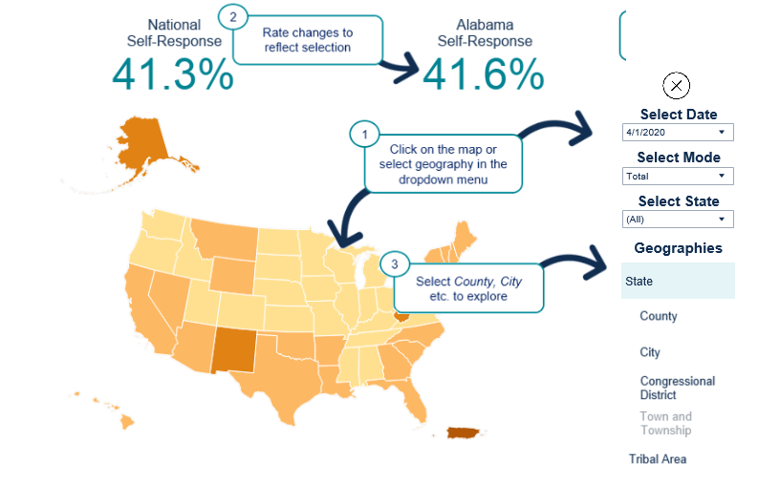
2020 Census Response Rate Map (National)
3
Notes:
Let’s get started with the 2020 Census….
As I mentioned , the Census is mandated by the United States Constitution and has been around since 1790.
In 1790, Thomas Jefferson was director of the first census. Then In 1790, they only needed 650 enumerators to count 3.9 million residents in 13 states. At the time New York City was the largest urban place with 33 thousand people. In 2010, the Census Bureau needed about 635 thousand enumerators to count a population of about 308 million people
To give you an idea of the magnitude of conducting a Census, A Census is the largest U.S. peacetime mobilization and operation conducted.
In 2020 we will be attempting to count over an estimated 330 million people in 140 million households.
The law requires the Census Bureau to keep your information confidential. Your responses are only used to produce statistics
All Census Bureau workers take a legally binding, lifetime oath to protect your information. Anyone who violates that oath could face jail time, a $250,000 fine, or both.

Slide 4
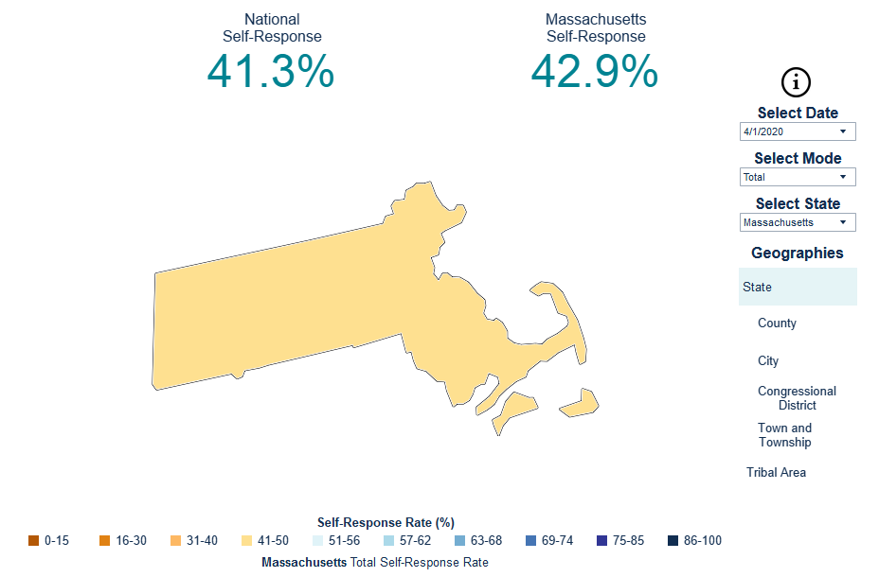
2020 Census Response Rate Map (State)
4
Notes:
Let’s get started with the 2020 Census….
As I mentioned , the Census is mandated by the United States Constitution and has been around since 1790.
In 1790, Thomas Jefferson was director of the first census. Then In 1790, they only needed 650 enumerators to count 3.9 million residents in 13 states. At the time New York City was the largest urban place with 33 thousand people. In 2010, the Census Bureau needed about 635 thousand enumerators to count a population of about 308 million people
To give you an idea of the magnitude of conducting a Census, A Census is the largest U.S. peacetime mobilization and operation conducted.
In 2020 we will be attempting to count over an estimated 330 million people in 140 million households.
The law requires the Census Bureau to keep your information confidential. Your responses are only used to produce statistics
All Census Bureau workers take a legally binding, lifetime oath to protect your information. Anyone who violates that oath could face jail time, a $250,000 fine, or both.

Slide 5
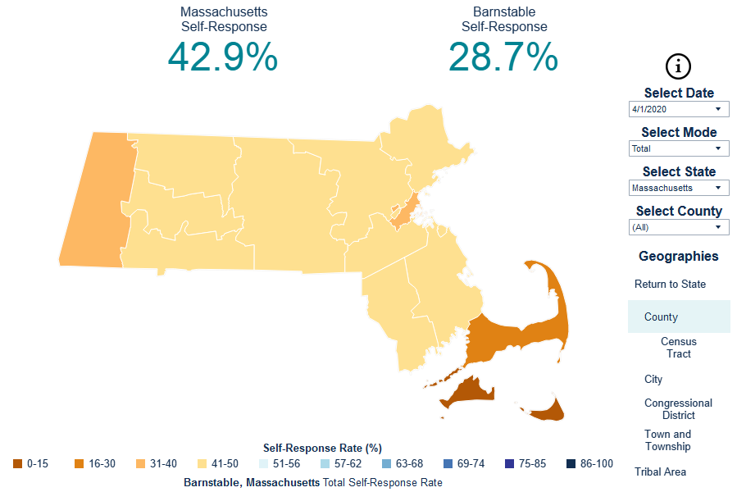
2020 Census Response Rate Map (County)
5
Notes:
Let’s get started with the 2020 Census….
As I mentioned , the Census is mandated by the United States Constitution and has been around since 1790.
In 1790, Thomas Jefferson was director of the first census. Then In 1790, they only needed 650 enumerators to count 3.9 million residents in 13 states. At the time New York City was the largest urban place with 33 thousand people. In 2010, the Census Bureau needed about 635 thousand enumerators to count a population of about 308 million people
To give you an idea of the magnitude of conducting a Census, A Census is the largest U.S. peacetime mobilization and operation conducted.
In 2020 we will be attempting to count over an estimated 330 million people in 140 million households.
The law requires the Census Bureau to keep your information confidential. Your responses are only used to produce statistics
All Census Bureau workers take a legally binding, lifetime oath to protect your information. Anyone who violates that oath could face jail time, a $250,000 fine, or both.

Slide 6
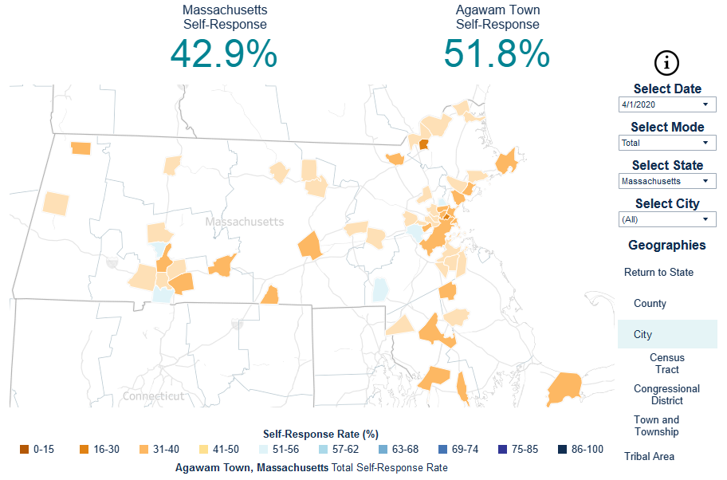
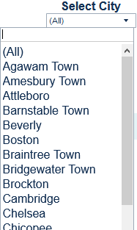
2020 Census Response Rate Map (City)
Defaults to first result alphabetically
6
Notes:
Let’s get started with the 2020 Census….
As I mentioned , the Census is mandated by the United States Constitution and has been around since 1790.
In 1790, Thomas Jefferson was director of the first census. Then In 1790, they only needed 650 enumerators to count 3.9 million residents in 13 states. At the time New York City was the largest urban place with 33 thousand people. In 2010, the Census Bureau needed about 635 thousand enumerators to count a population of about 308 million people
To give you an idea of the magnitude of conducting a Census, A Census is the largest U.S. peacetime mobilization and operation conducted.
In 2020 we will be attempting to count over an estimated 330 million people in 140 million households.
The law requires the Census Bureau to keep your information confidential. Your responses are only used to produce statistics
All Census Bureau workers take a legally binding, lifetime oath to protect your information. Anyone who violates that oath could face jail time, a $250,000 fine, or both.

Slide 7
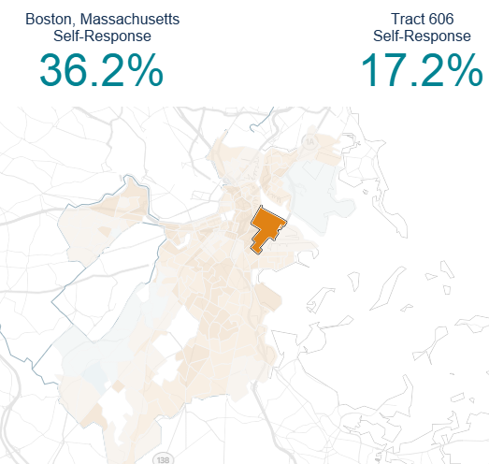
2020 Census Response Rate Map (Tract)
7
Notes:
Let’s get started with the 2020 Census….
As I mentioned , the Census is mandated by the United States Constitution and has been around since 1790.
In 1790, Thomas Jefferson was director of the first census. Then In 1790, they only needed 650 enumerators to count 3.9 million residents in 13 states. At the time New York City was the largest urban place with 33 thousand people. In 2010, the Census Bureau needed about 635 thousand enumerators to count a population of about 308 million people
To give you an idea of the magnitude of conducting a Census, A Census is the largest U.S. peacetime mobilization and operation conducted.
In 2020 we will be attempting to count over an estimated 330 million people in 140 million households.
The law requires the Census Bureau to keep your information confidential. Your responses are only used to produce statistics
All Census Bureau workers take a legally binding, lifetime oath to protect your information. Anyone who violates that oath could face jail time, a $250,000 fine, or both.

Slide 8
2020 Census Response Rate Map (Town)
8
Notes:
Let’s get started with the 2020 Census….
As I mentioned , the Census is mandated by the United States Constitution and has been around since 1790.
In 1790, Thomas Jefferson was director of the first census. Then In 1790, they only needed 650 enumerators to count 3.9 million residents in 13 states. At the time New York City was the largest urban place with 33 thousand people. In 2010, the Census Bureau needed about 635 thousand enumerators to count a population of about 308 million people
To give you an idea of the magnitude of conducting a Census, A Census is the largest U.S. peacetime mobilization and operation conducted.
In 2020 we will be attempting to count over an estimated 330 million people in 140 million households.
The law requires the Census Bureau to keep your information confidential. Your responses are only used to produce statistics
All Census Bureau workers take a legally binding, lifetime oath to protect your information. Anyone who violates that oath could face jail time, a $250,000 fine, or both.

Slide 9
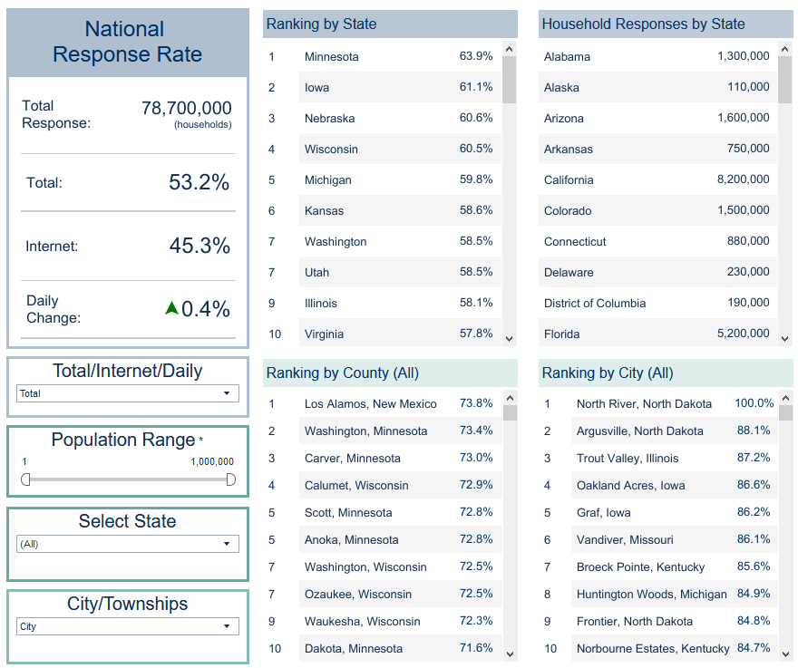
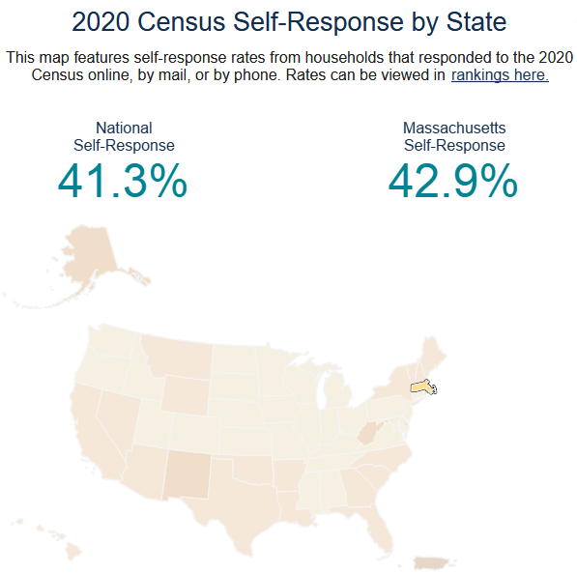
View the Rankings
9
Notes:
Let’s get started with the 2020 Census….
As I mentioned , the Census is mandated by the United States Constitution and has been around since 1790.
In 1790, Thomas Jefferson was director of the first census. Then In 1790, they only needed 650 enumerators to count 3.9 million residents in 13 states. At the time New York City was the largest urban place with 33 thousand people. In 2010, the Census Bureau needed about 635 thousand enumerators to count a population of about 308 million people
To give you an idea of the magnitude of conducting a Census, A Census is the largest U.S. peacetime mobilization and operation conducted.
In 2020 we will be attempting to count over an estimated 330 million people in 140 million households.
The law requires the Census Bureau to keep your information confidential. Your responses are only used to produce statistics
All Census Bureau workers take a legally binding, lifetime oath to protect your information. Anyone who violates that oath could face jail time, a $250,000 fine, or both.

Slide 10
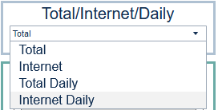
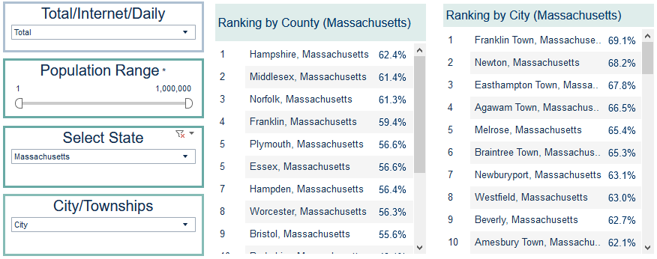
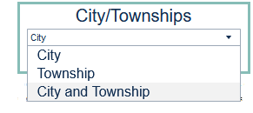
Rankings Options
10
Notes:
Let’s get started with the 2020 Census….
As I mentioned , the Census is mandated by the United States Constitution and has been around since 1790.
In 1790, Thomas Jefferson was director of the first census. Then In 1790, they only needed 650 enumerators to count 3.9 million residents in 13 states. At the time New York City was the largest urban place with 33 thousand people. In 2010, the Census Bureau needed about 635 thousand enumerators to count a population of about 308 million people
To give you an idea of the magnitude of conducting a Census, A Census is the largest U.S. peacetime mobilization and operation conducted.
In 2020 we will be attempting to count over an estimated 330 million people in 140 million households.
The law requires the Census Bureau to keep your information confidential. Your responses are only used to produce statistics
All Census Bureau workers take a legally binding, lifetime oath to protect your information. Anyone who violates that oath could face jail time, a $250,000 fine, or both.

Slide 11
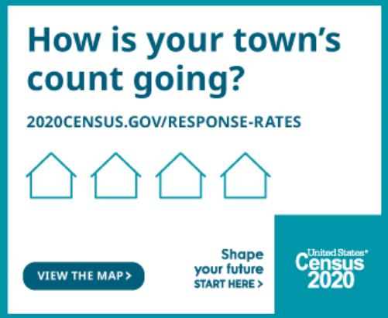
Have Fun with the Response Rate Challenge!
Complete your 2020 Census and challenge other people and communities to do theirs!
Click HERE ---> Toolkit
11
Notes:
Let’s get started with the 2020 Census….
As I mentioned , the Census is mandated by the United States Constitution and has been around since 1790.
In 1790, Thomas Jefferson was director of the first census. Then In 1790, they only needed 650 enumerators to count 3.9 million residents in 13 states. At the time New York City was the largest urban place with 33 thousand people. In 2010, the Census Bureau needed about 635 thousand enumerators to count a population of about 308 million people
To give you an idea of the magnitude of conducting a Census, A Census is the largest U.S. peacetime mobilization and operation conducted.
In 2020 we will be attempting to count over an estimated 330 million people in 140 million households.
The law requires the Census Bureau to keep your information confidential. Your responses are only used to produce statistics
All Census Bureau workers take a legally binding, lifetime oath to protect your information. Anyone who violates that oath could face jail time, a $250,000 fine, or both.

Slide 12
Contact Us
Partnership Program
New York Regional Office
Phone: (212) 882-2130
Email: new.york.rcc.partnership@2020census.gov
Philadelphia Regional Office
Phone: (215) 717-1800
Email: Philadelphia.rcc.partnership@2020census.gov
Data Dissemination Program
Email: census.askdata@census.gov
Phone: 1-844-ASK-DATA
Website: www.census.gov/data/training-workshops.html
12

